Slide 1
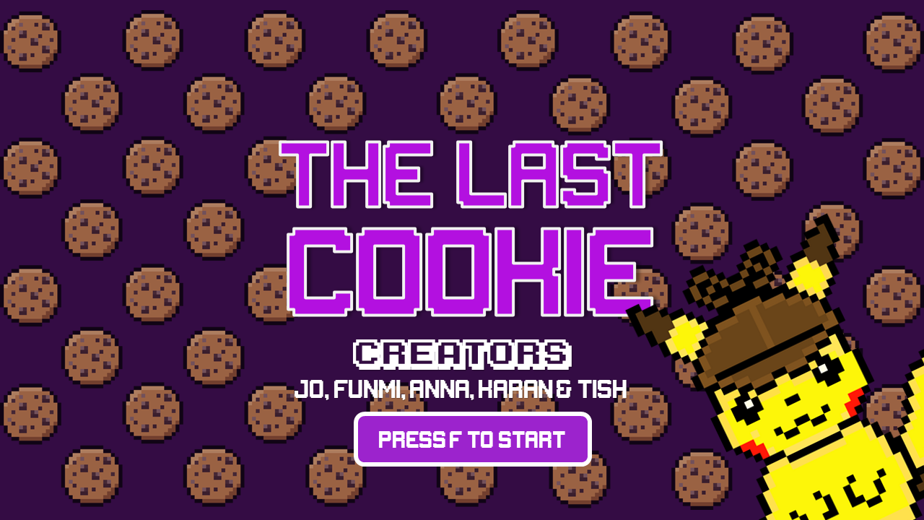

Slide 2
Introduction
WHAT
WHY
‘The Last Cookie’ is a hybrid text-based adventure game and mini game compilation of cookie and bakery themed adaptations of classic childhood games.
Many of us have an interest in gaming and game development, so we wanted to utilise this experience to develop our skills. We understood that text based games were an excellent way of enhancing our object-oriented programming skillset, but also wanted to challenge ourselves to see beyond the command line by making games with graphical elements.

Slide 3
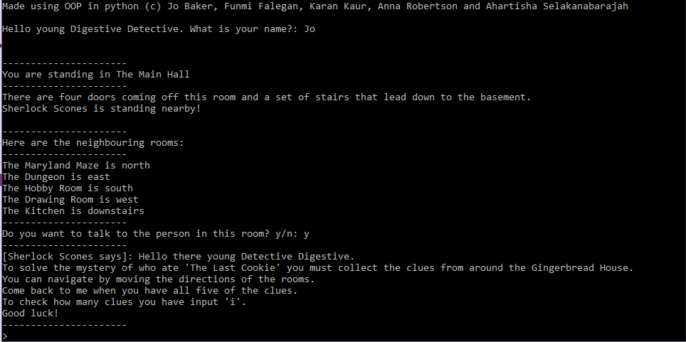
THE GAME

Slide 4
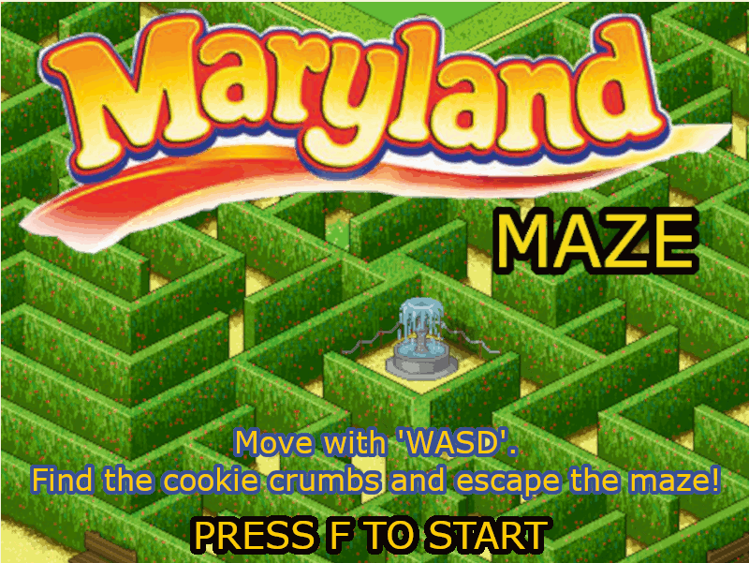
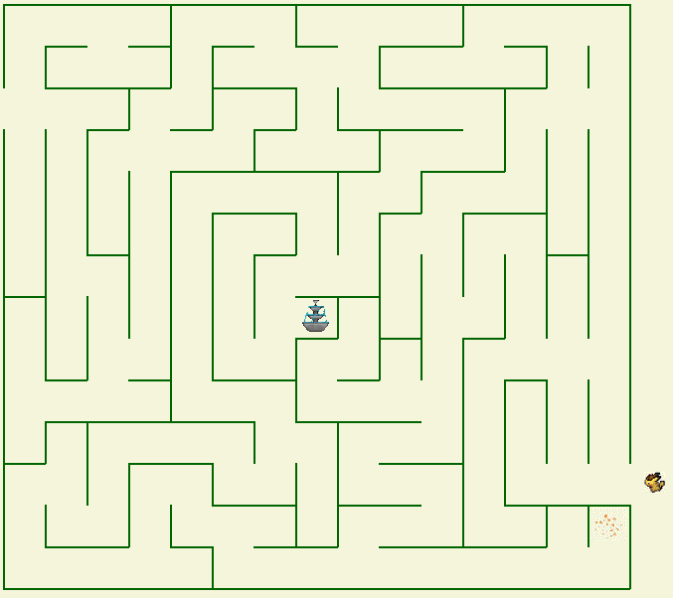
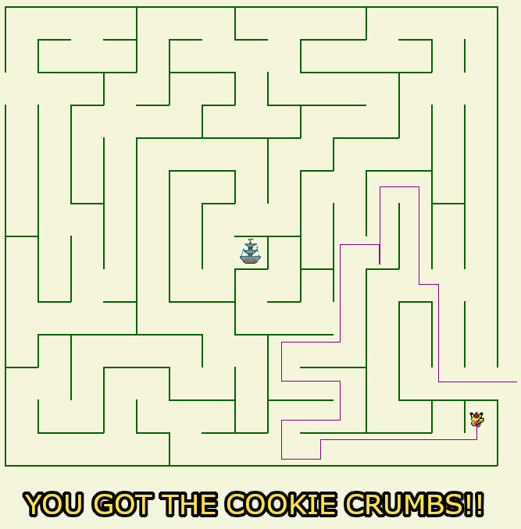
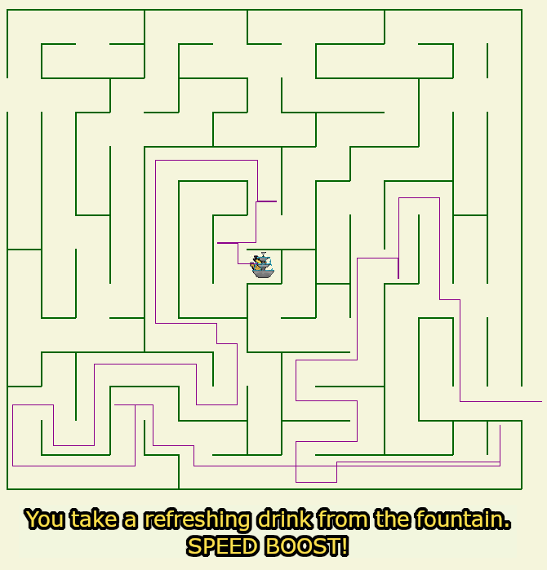
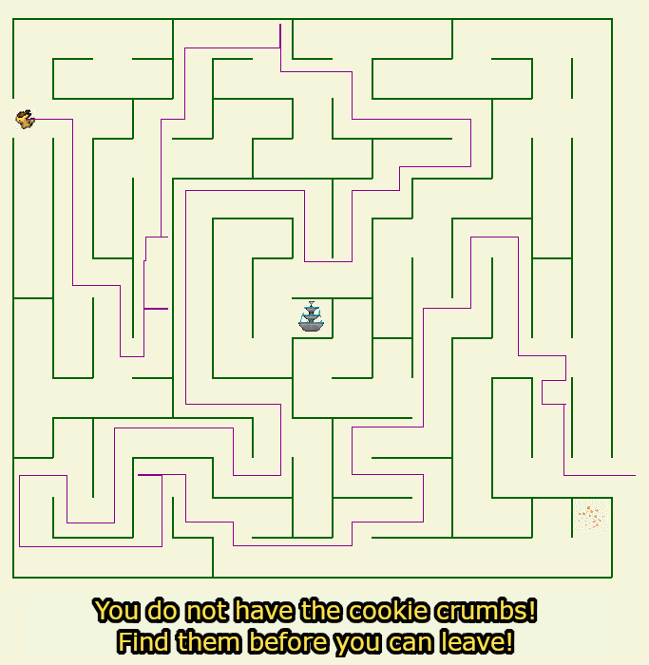
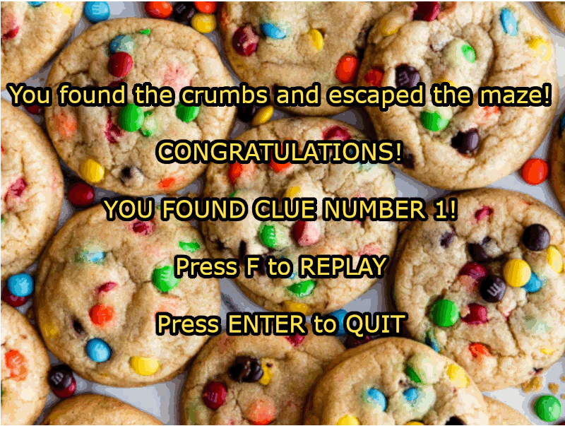

Slide 5
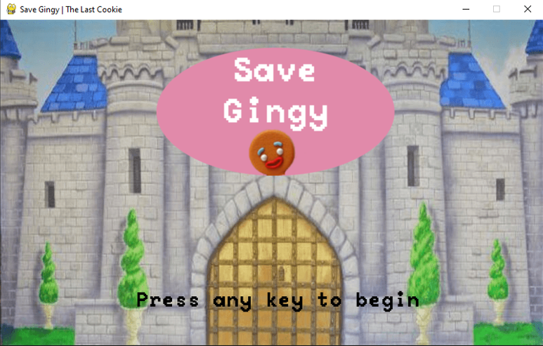
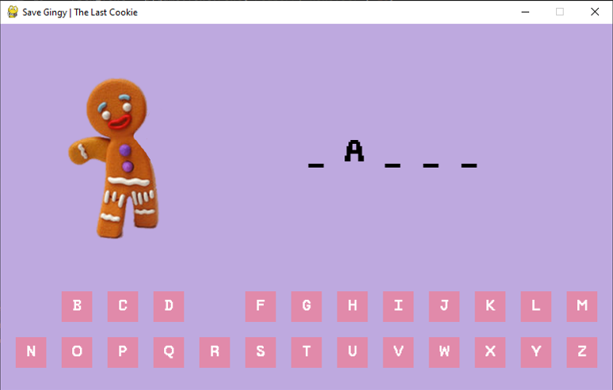
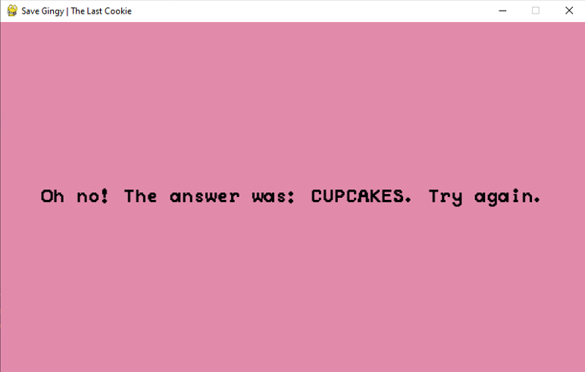

Slide 6
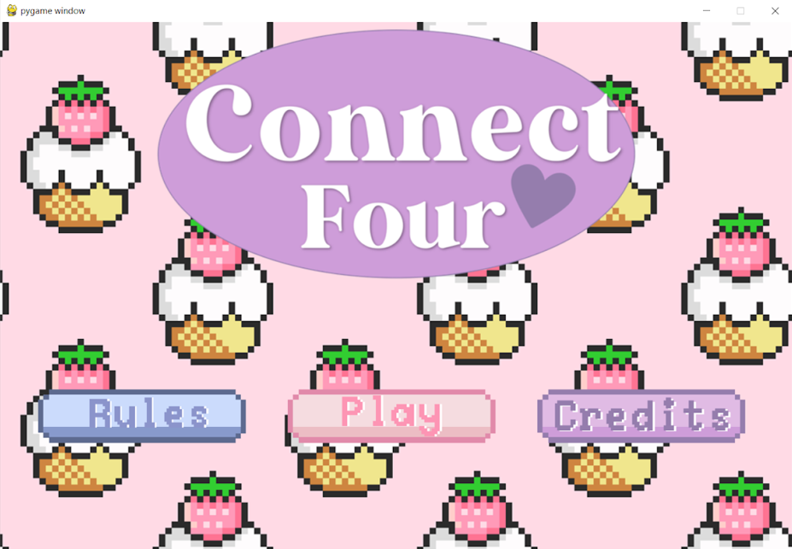
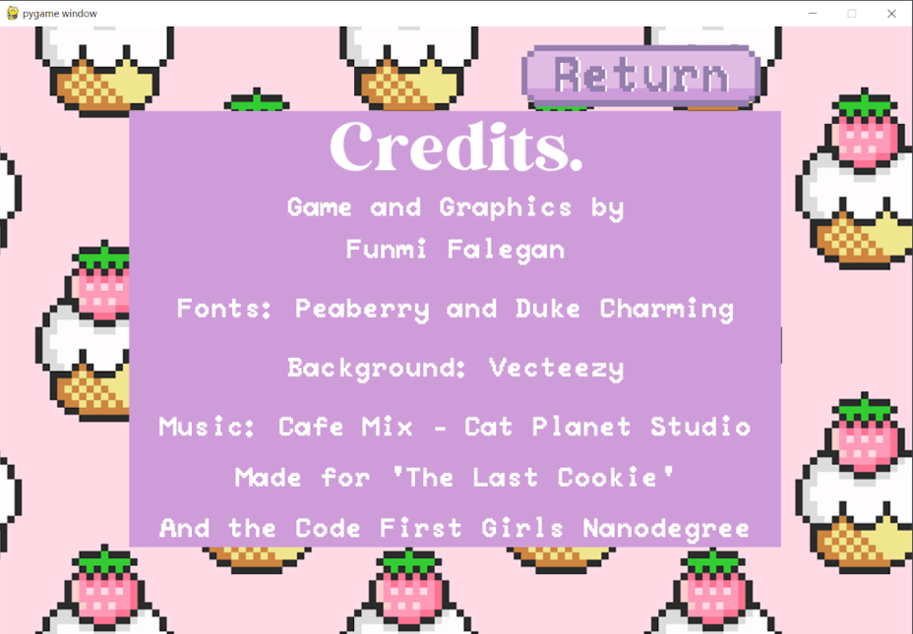

Slide 7
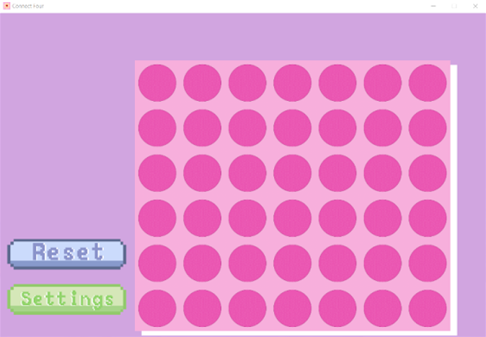
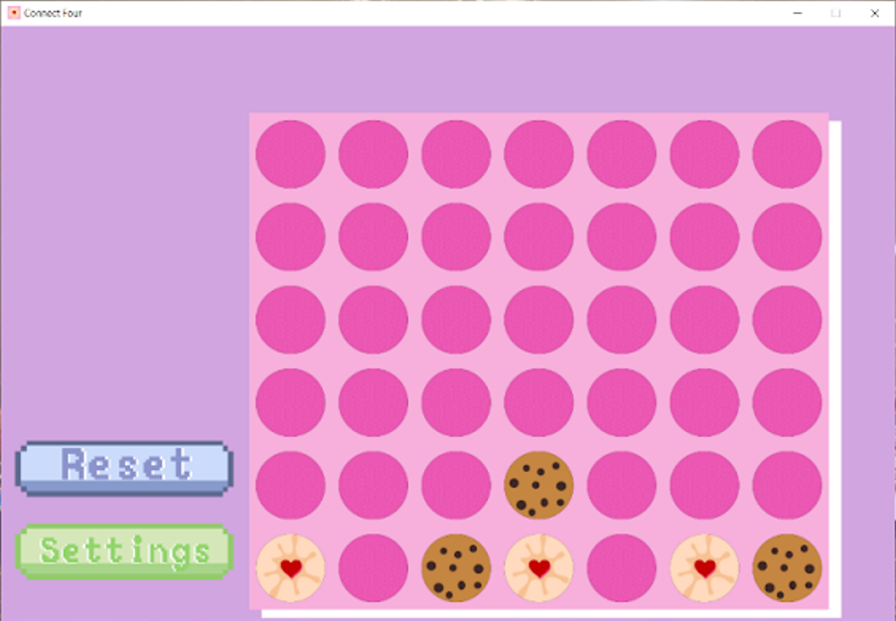
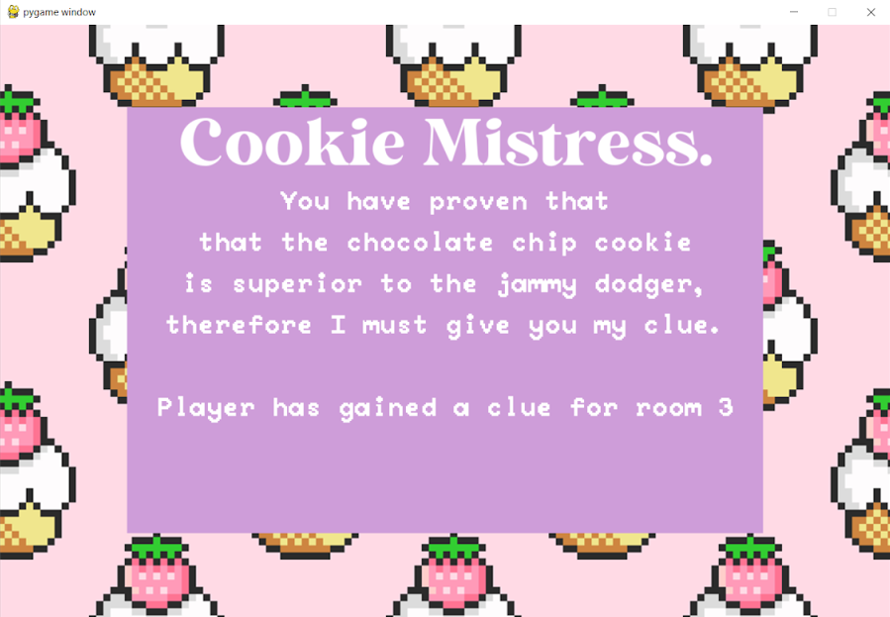

Slide 8
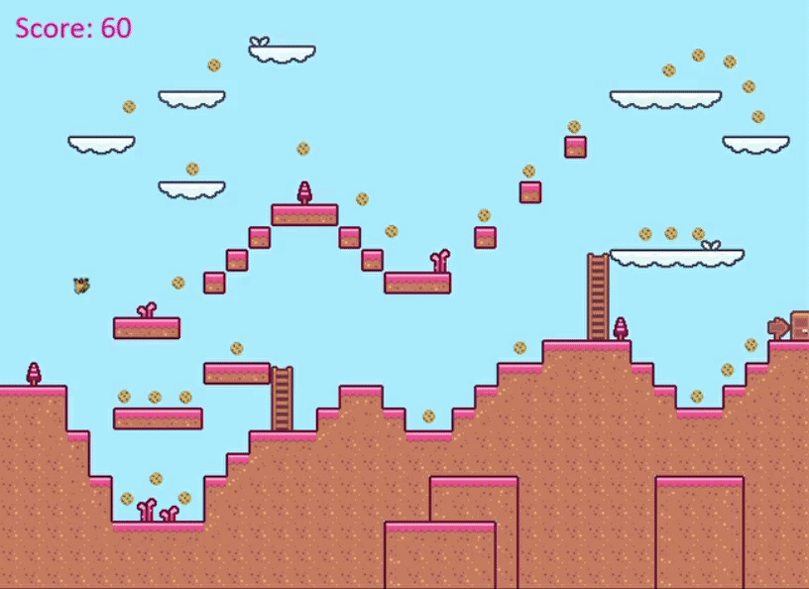
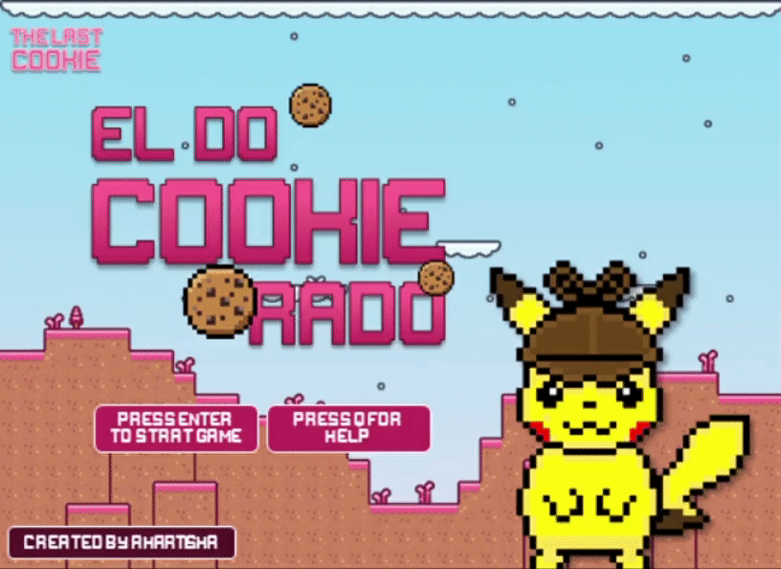
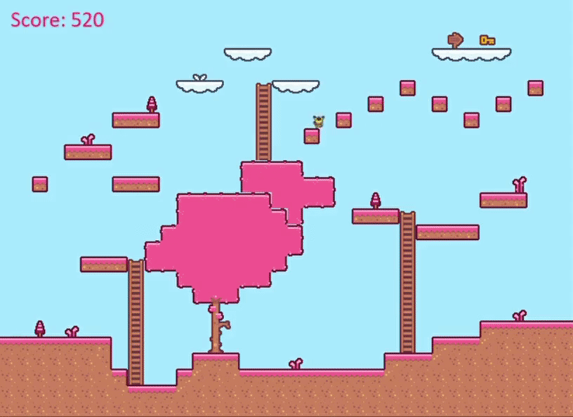

Slide 9
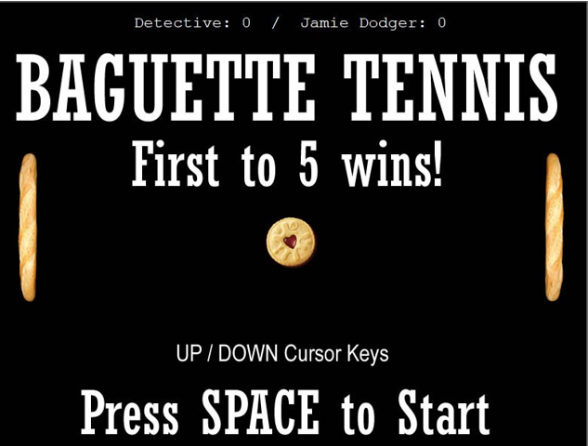
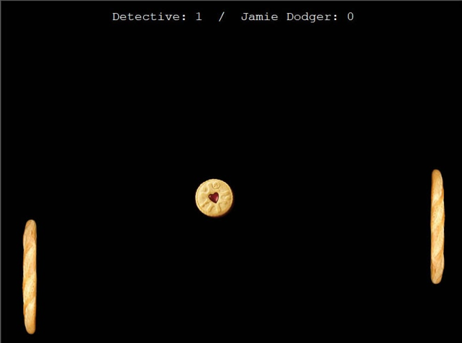
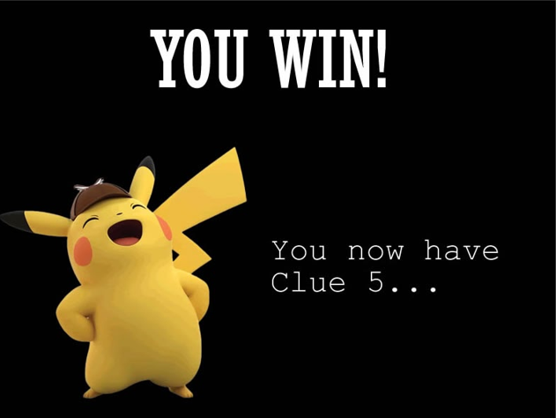
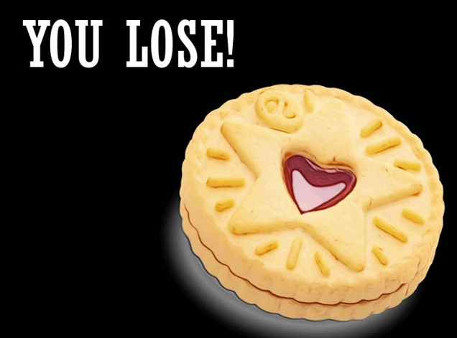

Slide 10
Challenges
Self-directed learning of Pygame, Turtle, Arcade and other modules in a short time frame
Creating .exe files for each of the mini games so they could be run from within the text adventure
Bringing all the mini games together into the main game
Structuring of large python projects (and keeping it the same for everyone!)
Learning python naming conventions
Pygame/game logic is not suited to unit testing

Slide 11
Improvements
Incorporate graphics into the adventure game such as a title screen, either in Tkinter or one of the three modules we used in the mini games
Only giving the clue when the player wins the mini game (it is currently set to give the clue when they visit the room)
Improved consistency in UI and UX e.g. controls, layout and interface etc.
Give the clues a storyline (rather than generic ‘Clue One’) and have the culprit be one of the characters encountered in the game
Ensuring there is a efficient run time on each PC: this would require researching of pygame optimisation on different devices

